Slide 1
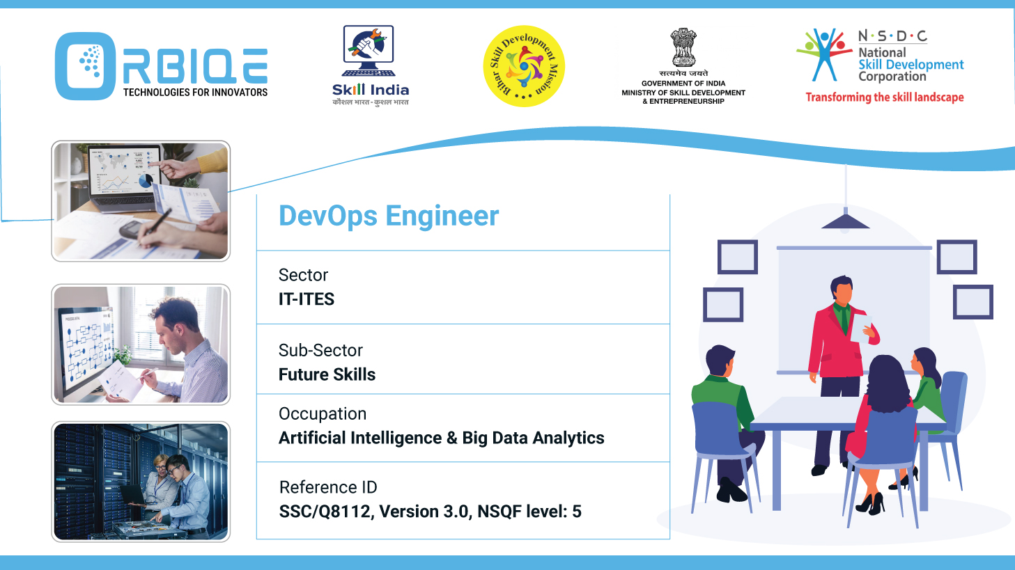
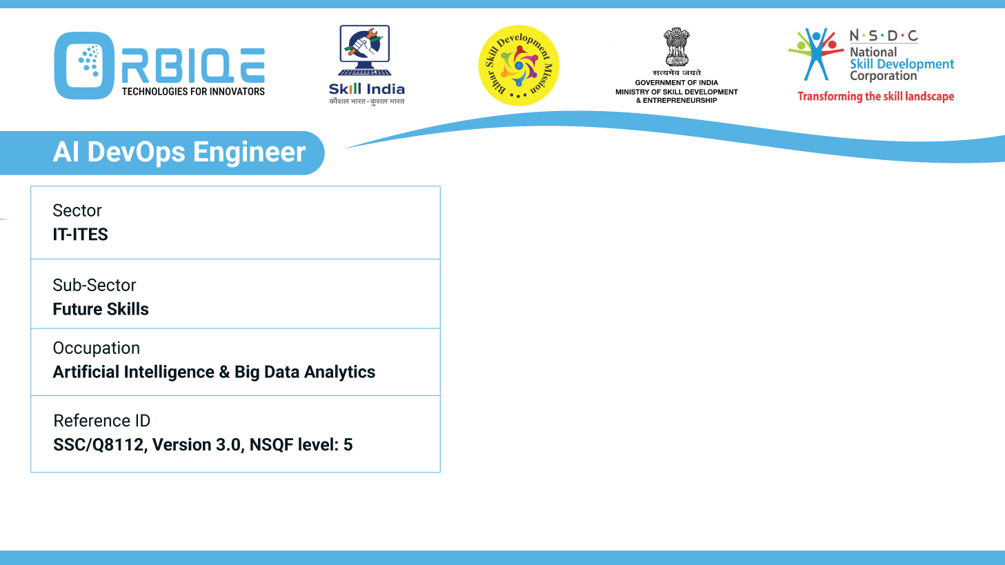
Name- Krishna Kant Dubey

Slide 2

Overview of Global Data Regulations and Standards

Slide 3
Agenda
Discuss the need for data regulations and standards
Analyse commonly used global data regulation policies (such as GDPR)
Discuss the roles and responsibilities of key actors involved in enforcing data regulations and standards
Organizations in the enforcement of data regulations and standards

Slide 4
Organizations in the enforcement of data regulations and standards

Slide 5
Analyze commonly used global data regulation policies (such as GDPR)

Slide 6
Discuss the roles and responsibilities of key actors involved in enforcing data regulations and standards

Slide 7
Organizations in the enforcement of data regulations and standards

Slide 8
Thank You

